Slide 1
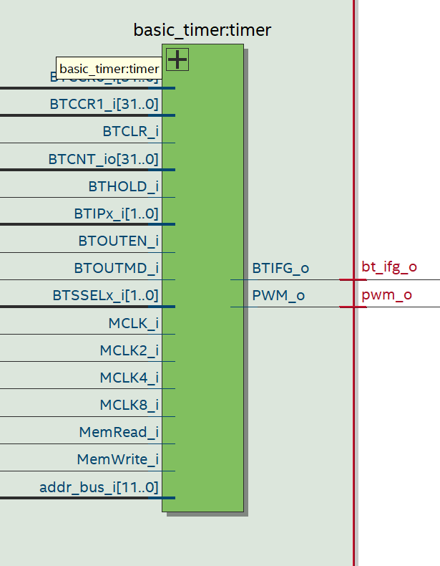
Figure 11 - Basic timer component

Slide 2
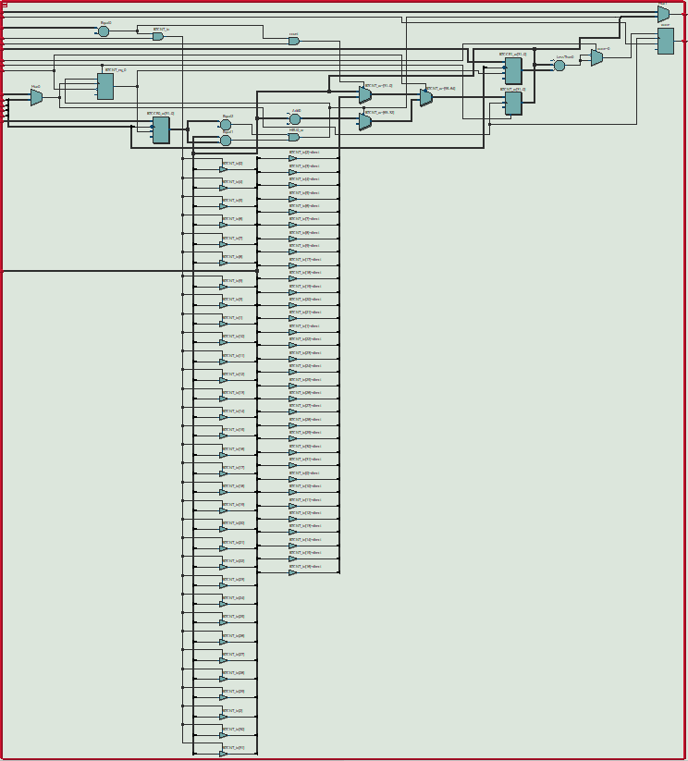
Figure 12 -RTL – basic timer

Slide 3
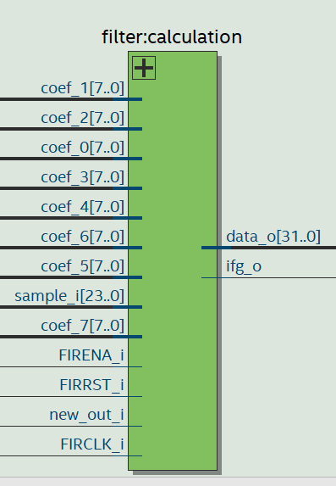
Figure 18 -Calculation component in the FIR

Slide 4
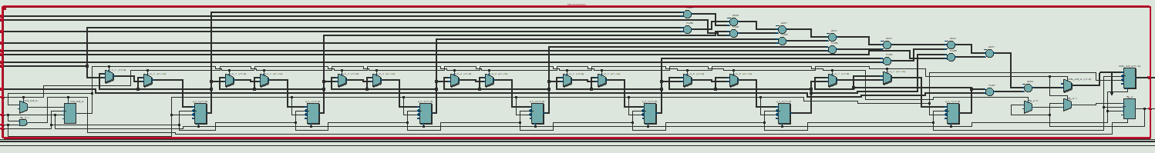
RTL – calculation component in the FIR

Slide 5
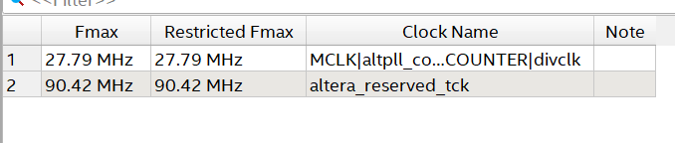
Figure 30 -Fmax of the system

Slide 6
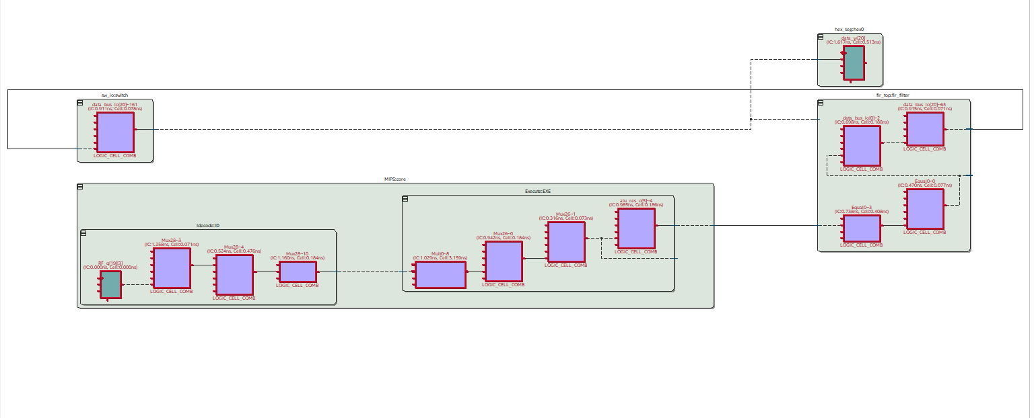
HEX seg
switches
FIR
MIPS
Critical path

Slide 7
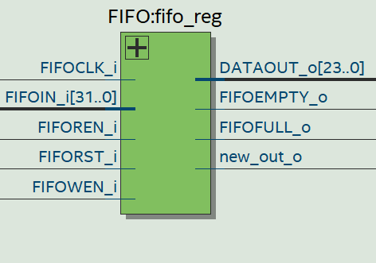
Figure 20 -FIFO register component

Slide 8
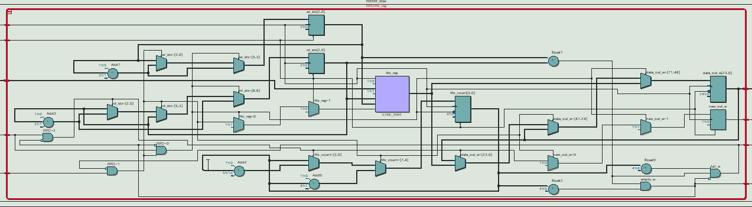
RTL – FIFO reg

Slide 9
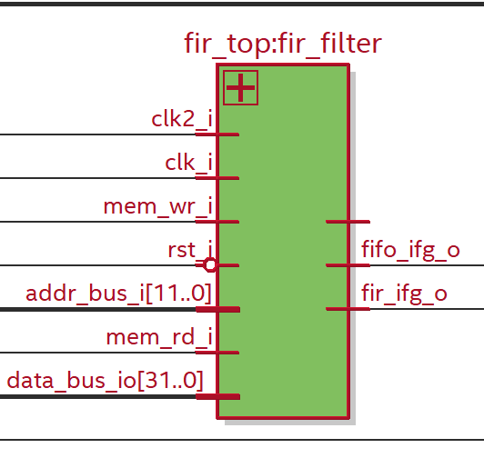
Figure 14 -FIR top component

Slide 10
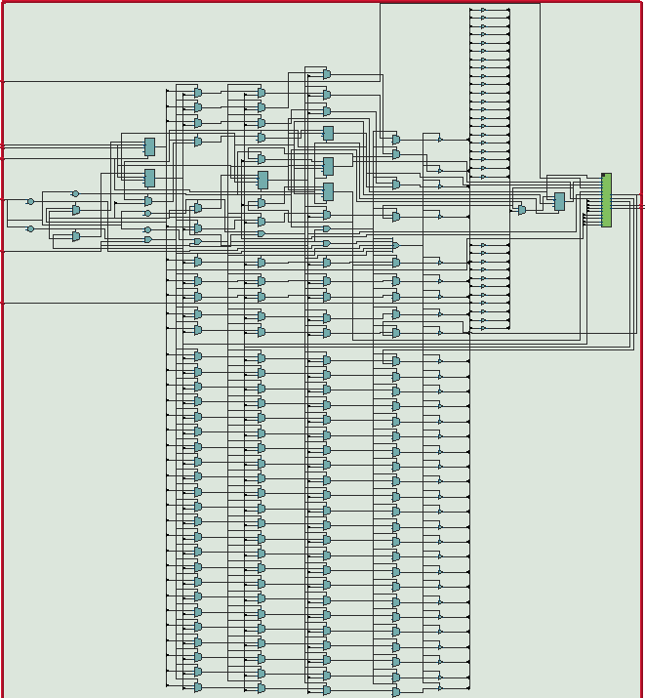
FIR
Figure 15 -RTL – FIR top

Slide 11
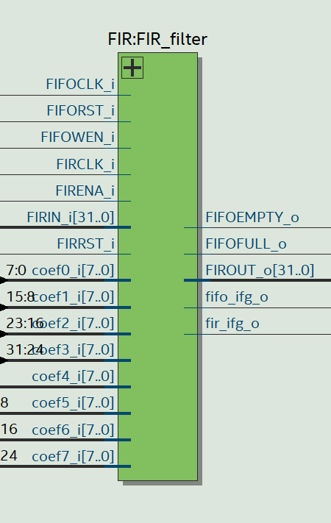
Figure 16 -FIR component

Slide 12
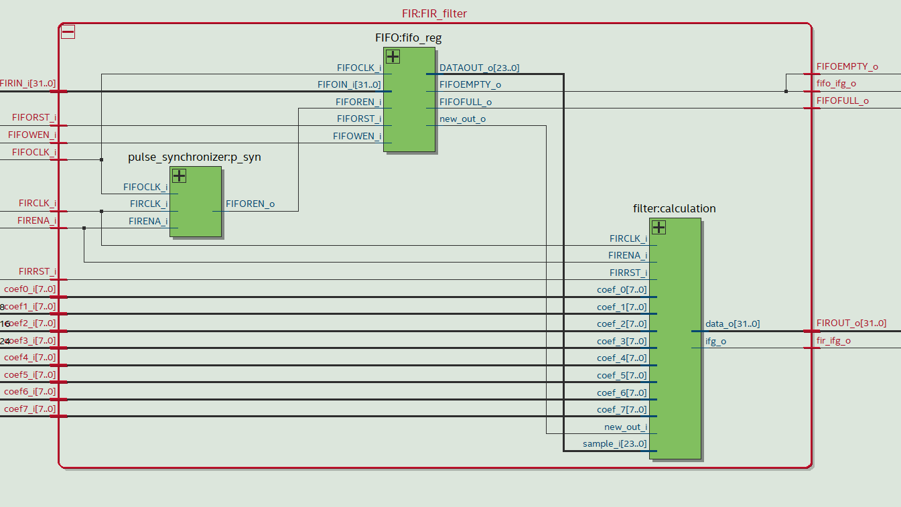
Figure 17 - RTL FIR

Slide 13
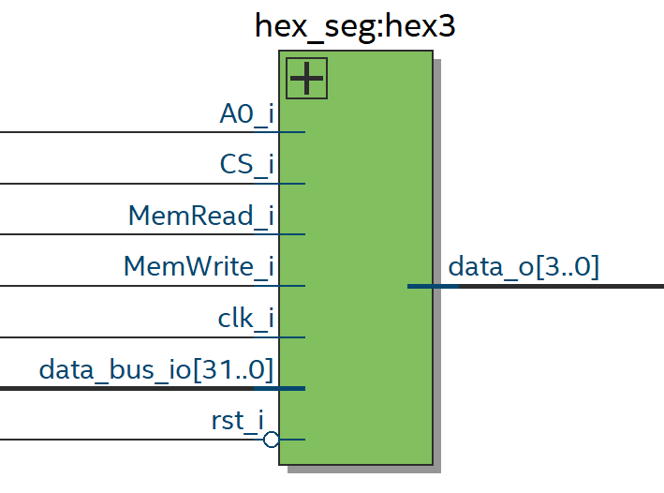
Figure 4- HEX seg component

Slide 14
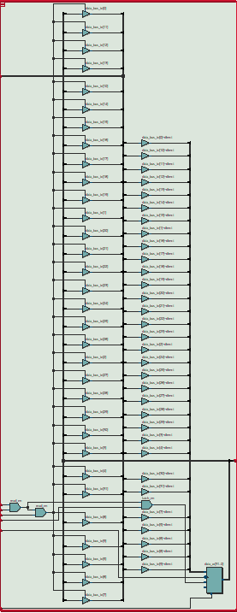
Figure 5 -RTL HEX seg

Slide 15
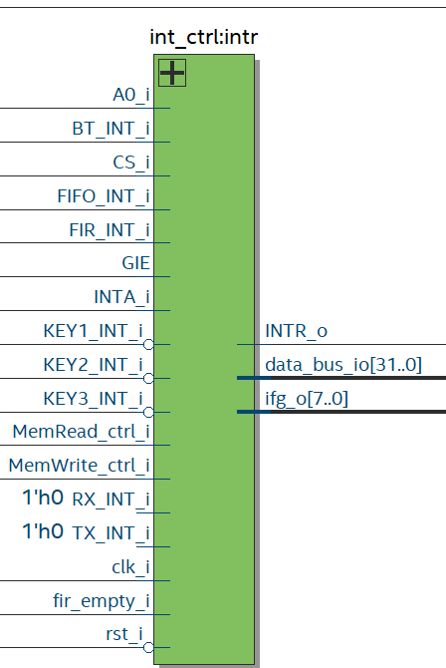
Figure 26 -Interrupt controller component

Slide 16
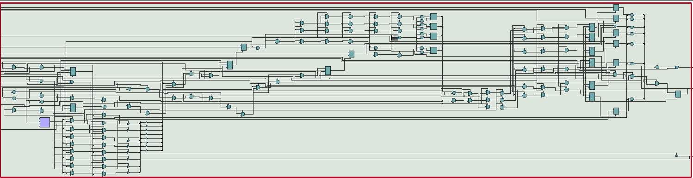
RTL interrupt controller

Slide 17
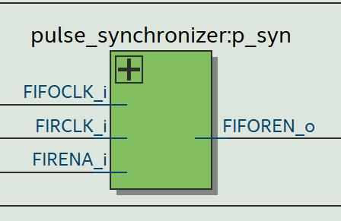
Figure 22 -Pulse Synchronizer component

Slide 18
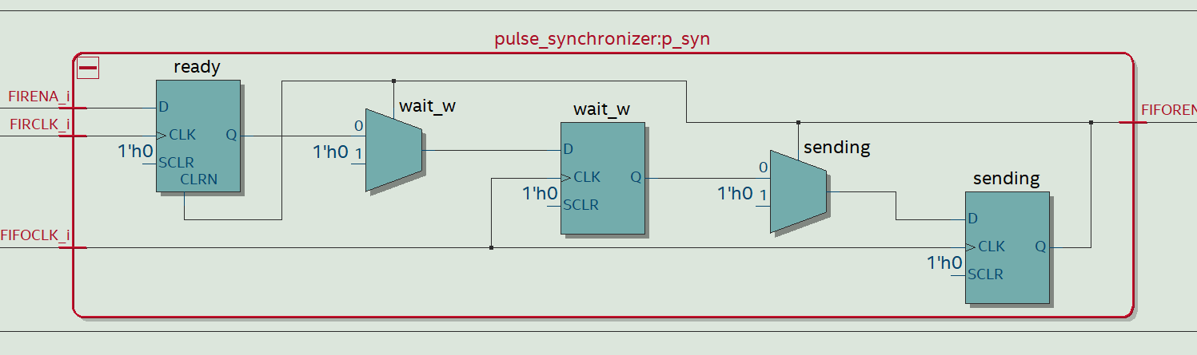
RTL Pulse Synchronizer

Slide 19
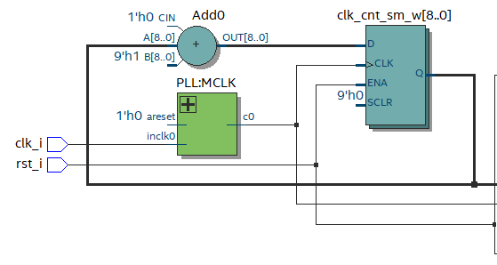
RTL of creating 2 different clocks

Slide 20
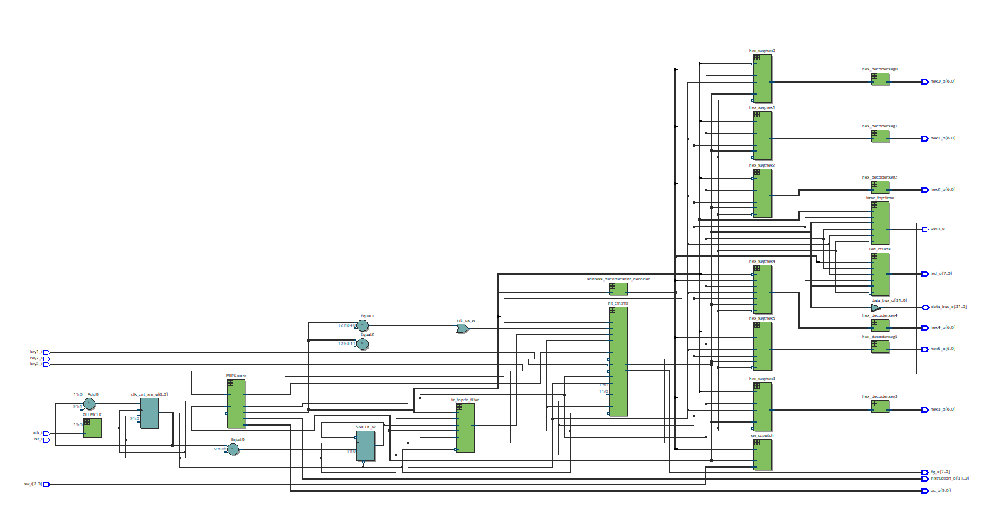
Figure 28 -RTL - MCU

Slide 21
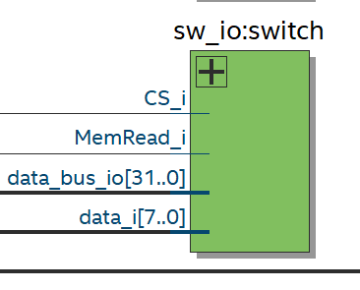
Figure 6 -Switches in_out component

Slide 22
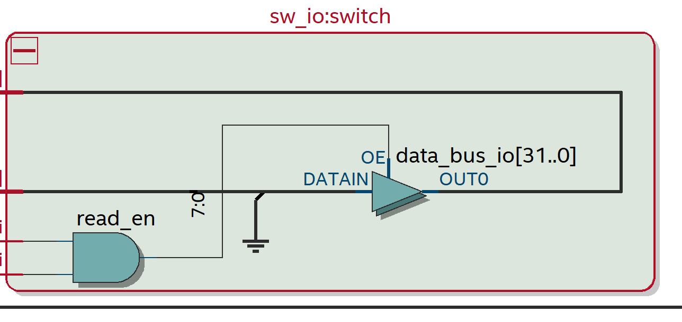
Figure 7- RTL SW

Slide 23
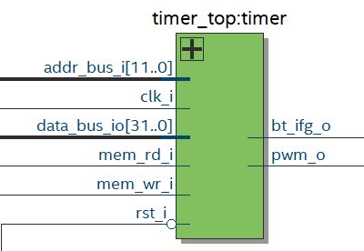
Timer tope component

Slide 24
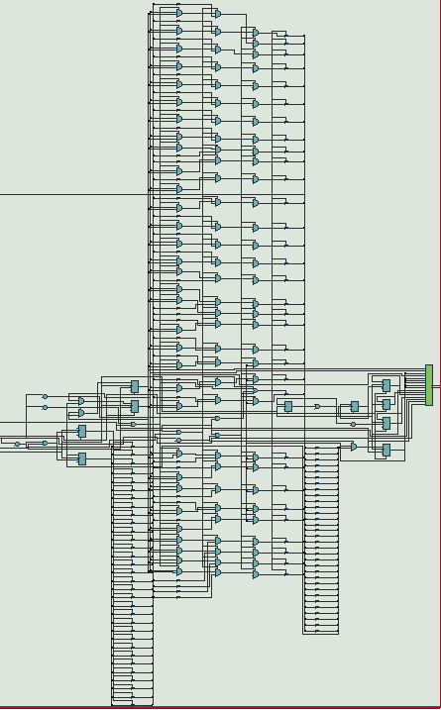
RTL timer top component

Slide 25
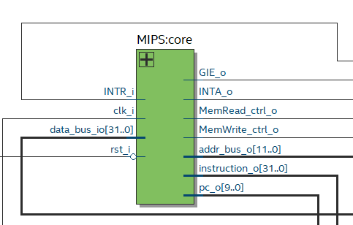
Figure 8 -MIPS component

Slide 26
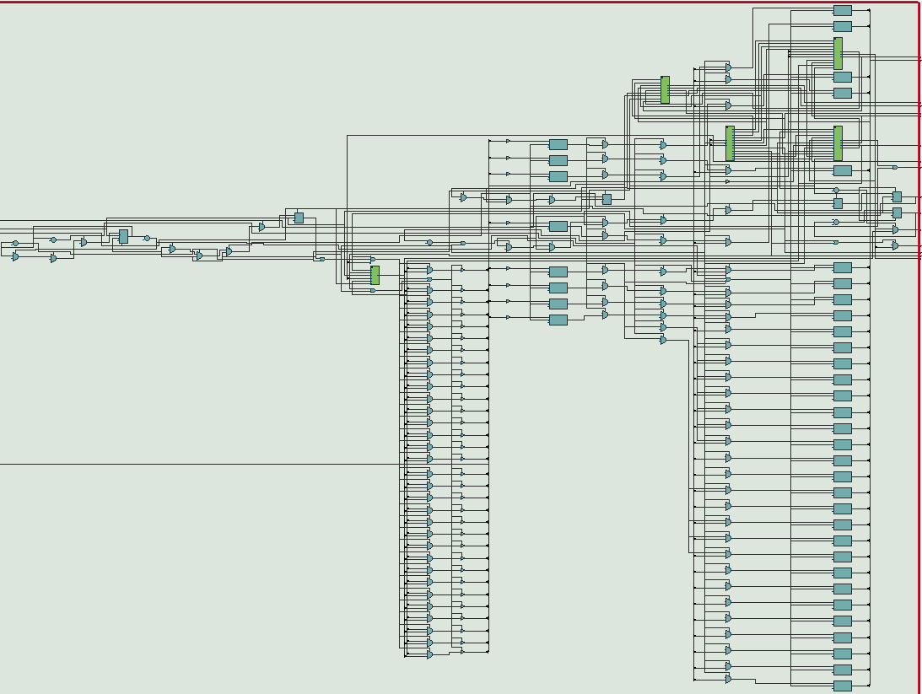
Figure 9 -RTL MIPS

Slide 27
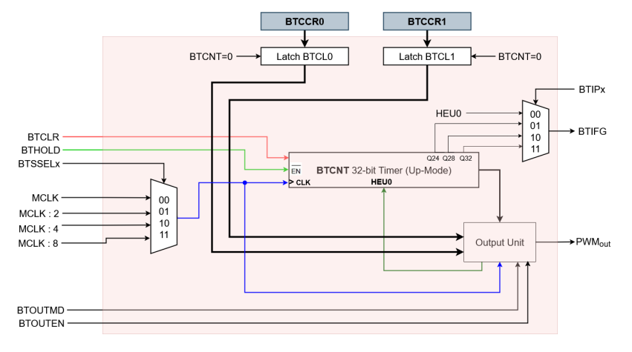
Figure 10 – Basic Timer

Slide 28
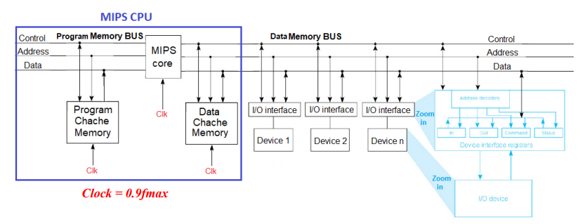
Figure 1 – MCU architecture

Slide 29
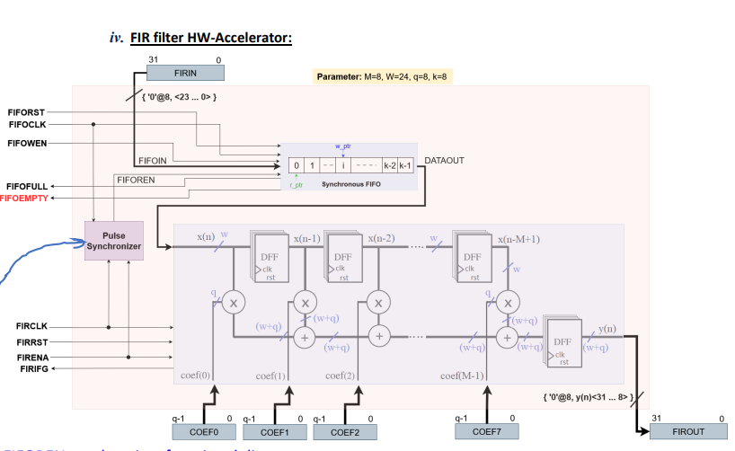
Figure 13 – FIR filter

Slide 30
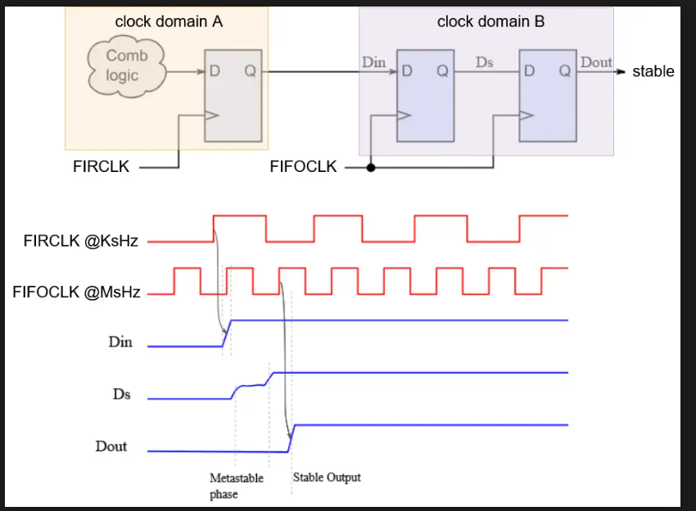
Figure 24 – pulse synchronizer “algorithm”

Slide 31
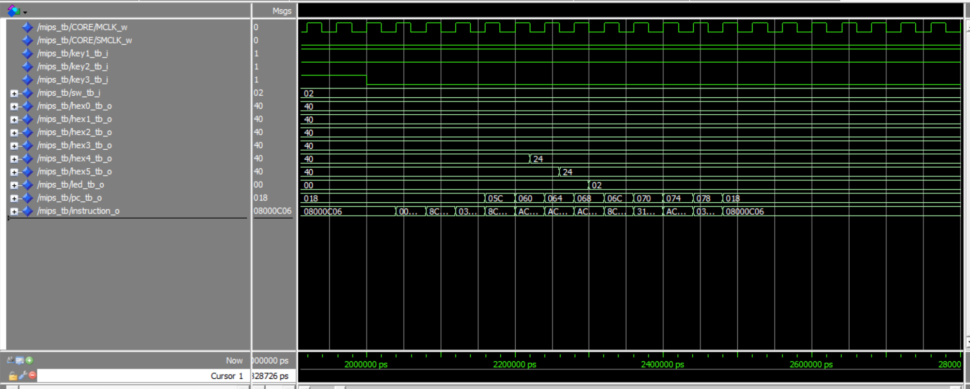
Figure 31 – model sim for test 1

Slide 32
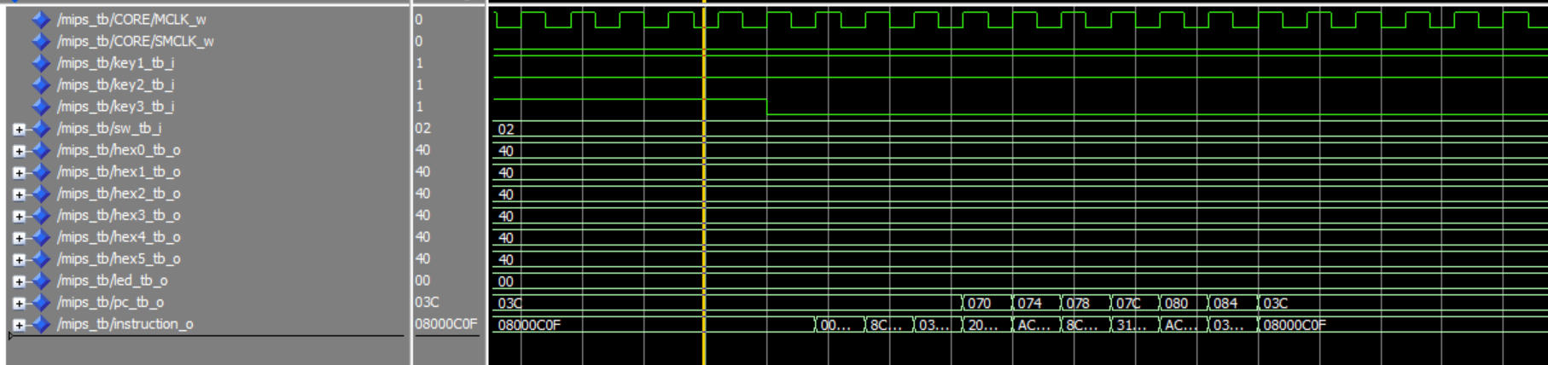
Figure 32 – Model Sim for test 2

Slide 33
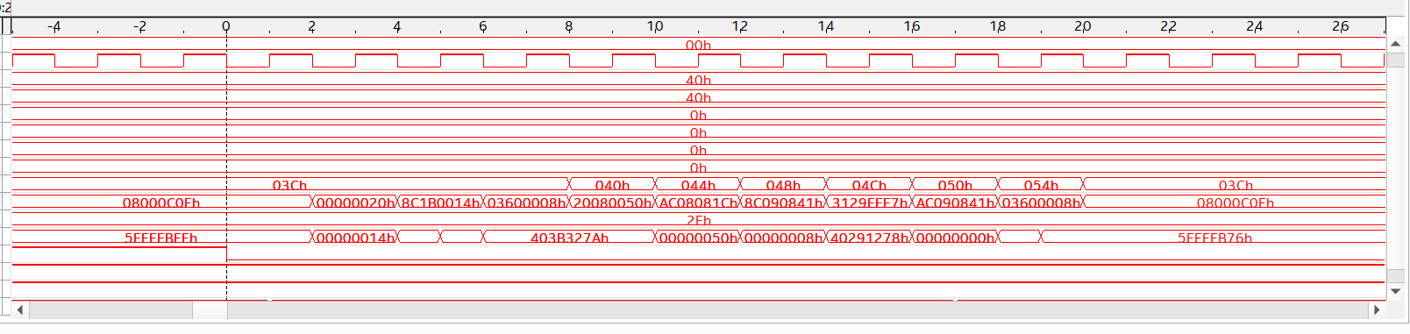
Figure 33 - Test 2 in Quartus

Slide 34
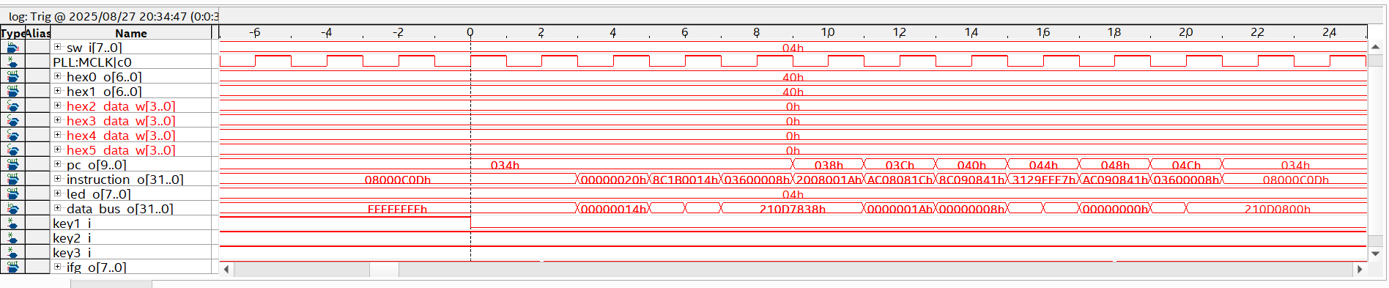
Figure 33 - Test 3 in Quarus

Slide 35
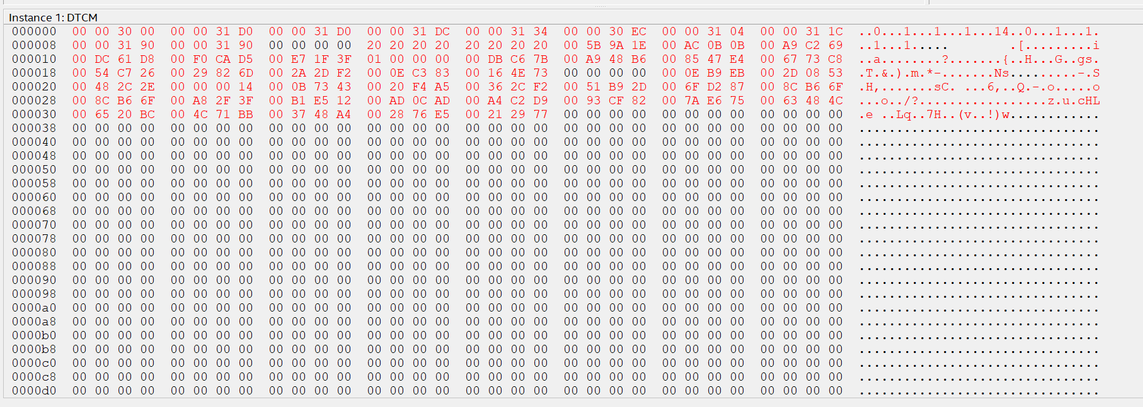
Figure 34 - Memory after running test 4 in the Quartus

Slide 36
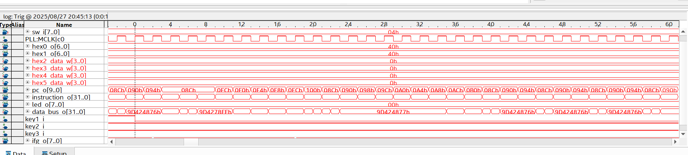
Figure 35 - Interrupt for test 4 in Quartus

